Slide 1
MARRS: Rover 3D Explorations Workshop
MARRS Summer Workshop 2019
Jackson State University

Slide 2
Who we are…
Dr. Steve Hsiung
Professor of Electrical Engineering Technology
Old Dominion University – Norfolk, VA
Dr. Walt Deal
Associate Professor of Industrial Technology
Old Dominion University – Norfolk, VA
Dr. Feng Jao
Associate Professor of Technological Studies
Ohio Northern University, Ada, OH

Slide 3
Cool things - path ways to Science, Technology, Engineering, & Math Related Careers

Slide 4
What we are going to do…
Explore 3D design and printing
Make a 3-D printed part
Fabricate a 3D printed Robot Rover
Program an Arduino Microcontroller
Test a programmed Robot Rover
Participate in a competitive event
Explore STEM related careers and other opportunities
Everything is available on: www.ucdistancetraining.org

Slide 5
Arduino…

Slide 6
Arduino and Science…
Arduino is a microcontroller … small computer! More later!
Tool to do cool things…
Programmable…
Very low cost…
Easy to use!
Versatile!

Slide 7
What can I do?
Even if you have only ONE!

Slide 8
Things we can do…
Measure…
Temperature
Measure pH
Light
Motion – proximity…
Presence absence
Robotic control of camera
Pressure
Data collection
Storing date
Sampling
Solar Tracking
Moisture measure – plants
Photometer
Green house control
Hydroponics

Slide 9
3D printing – Fabrication Coding, Testing, & Operation

Slide 10
3D Robot Rover

Slide 11
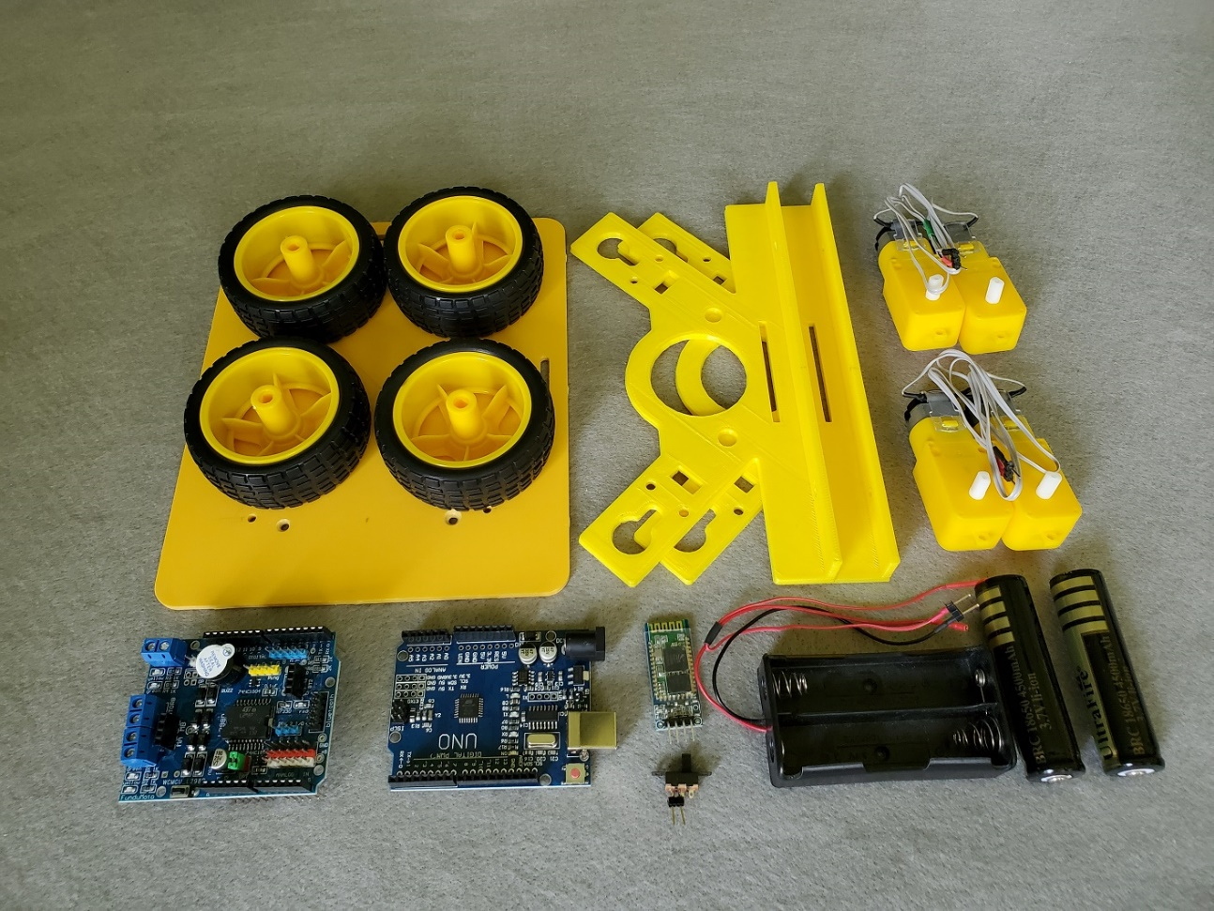
Printing the Rover Parts and Assembly

Slide 12
Working with Autodesk Inventor
What is Autodesk Inventor
Professional 3D mechanical design tool
Allow product development lifecycle and Cloud management, and enable assembly reconfigurations!
Easy to start and powerful for professional 3D design!

Slide 13
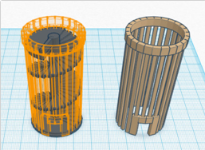
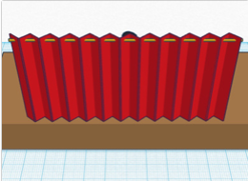
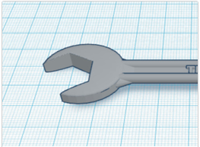
Learning the Basics…
Learning the Moves
Camera Controls
Creating Holes

Slide 14
What is a 3D Model

Slide 15
Autodesk Inventor https://youtu.be/DEhj0lmFSt8

Slide 16
What is 3D Printing…
Processes used to create a three-dimensional object in which layers of material are formed under computer control to create an object.
Additive process – building by adding material
Produced from 3D model or data

Slide 17
Programming Arduino UNO

Slide 18
Team Skills
Why team skills are important
Improve productivity
Diversity of ideas and solutions
Expand learning experiences
Building skills for success

Slide 19
Why 3D printing is important
It is an additive manufacturing that emphasizes the transformation of a 3-dimensional (3D) design model, typically specified as a 3D CAD (Computer Aided Design) model file, is directly and automatically fabricated via a machine, such as a 3D Printer, without the need for any intermediate manufacturing processes.

Slide 20
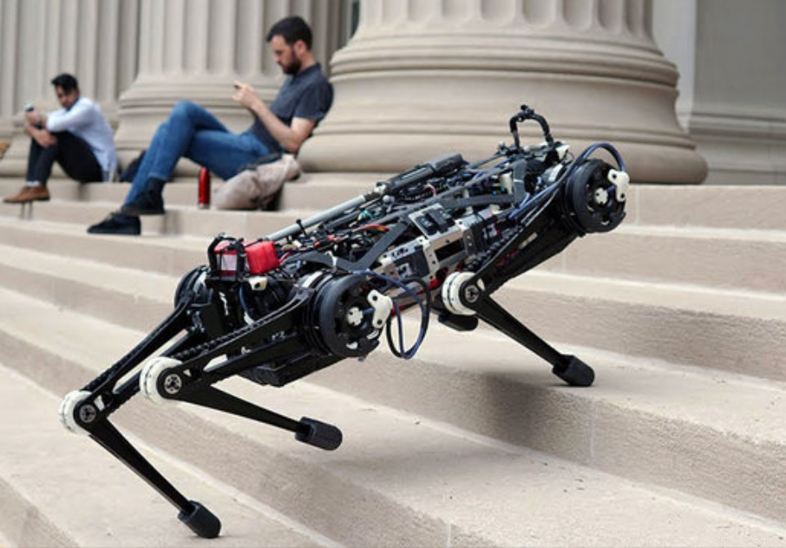
What is a robot?
A robot is a machine—especially one programmable by a computer— capable of carrying out a complex series of actions automatically.

Slide 21
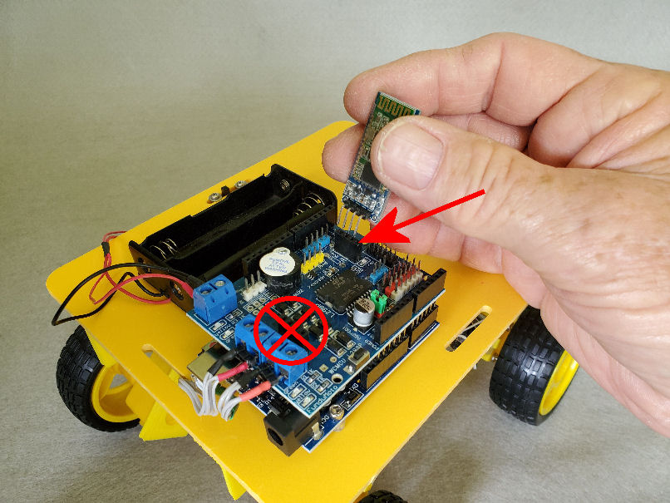
JSU Rover Project
Autonomous Rover – Rule-based decisions to find its way…
Bluetooth Rover – Smart phone app provides human control

Slide 22
What is Arduino?
Arduino is an open-source electronics platform based on easy-to-use hardware and software. Arduino boards are able to read inputs - light on a sensor, a finger on a button, or a Twitter message - and turn it into an output - activating a motor, turning on an LED, publishing something online.
You can tell your board what to do by sending a set of instructions to the microcontroller on the board. We use the Arduino programming language (based on Wiring), and the Arduino Software (IDE), based on Processing.

Slide 23
Programming JSU Rover
The Code – C+ like language
Create and write
Compile and test
Upload to Arduino and run

Slide 24
Education and Careers
Technical
Technology
Math and Science
Engineering
Apprenticeships, Community College, & University
Military service

Slide 25
Where to find us:
ODU: Steve Hsiung, shsiung@odu.edu,
757-683-4606
ODU: Walt Deal, wdeal@odu.edu, 757-928-5454
ONU: Feng Jao, f-jao@onu.edu, 419-772-2172

